Slide 1
UNIT 5
Virtual Memory
CO5
Explain virtual memory management

Slide 2
5.0 Introduction
5.1 Background, Demand paging
5.2 Copy-on-write, Page replacement
5.3 FIFO Algorithm
5.4 LIFO Algorithm
5.5 LRU Algorithm
5.6 Allocation of frames

Slide 3
5.0 INTRODUCTION
The goal of memory management strategies is to keep many processes in memory simultaneously to allow multiprogramming.
But they tend to require that an entire process be in the memory before it can execute.
Virtual Memory is the technique that allows the execution of processes that are not completely in memory.
Advantage of this scheme is abstract of main memory into extremely large, uniform array of storage, separating logical memory as viewed by the user from physical memory.
VM also allows processes to share files easily an to implement shared memory.
It provides an efficient mechanism for process creation.

Slide 4
5.1 Background, Demand paging
Background
Virtual memory – separation of user logical memory from physical memory.
  Only part of the program needs to be in memory for execution
  Logical address space can therefore be much larger than physical address space
  Allows address spaces to be shared by several processes
  Allows for more efficient process creation
  VM makes the task of programming much easier, because the programmer has no need to worry about the amount of physical memory available.
Virtual memory can be implemented via:
  Demand paging
  Demand segmentation

Slide 5
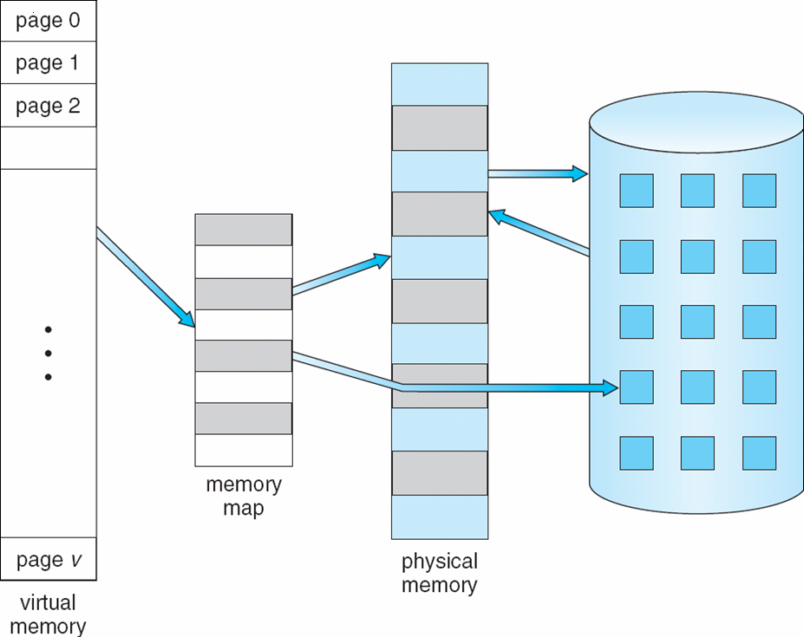
Fig: Virtual Memory That is Larger Than Physical Memory
⇒

Slide 6

Fig: Virtual-address Space
The Virtual address space of a process refers to the logical or virtual view of how a process is stored in memory.
A process begins at a certain logical address-say address 0 and exists in contiguous memory.
The physical memory may be organized in page frames and that the physical page frames assigned to a process may not be contiguous.
It is upto the MMU to map logical pages to physical page frames in memory

Slide 7
The heap is allowed to grow upward in memory as it is used for dynamic memory allocation.
Similarly, the stack is allowed to grow downward in memory through successive function calls
The large blank space or hole between the heap and stack is part of the virtual address space but will require actual physical pages only if the heap or stack grows.
Virtual address spaces that include holes are known as sparse address spaces.
VM allows files and memory to be shared by two more processes through page sharing.
System libraries can be shared by several processes through mapping of the object into a virtual address space.
Although each process considers the shared libraries to be part of its virtual address space, the actual pages where the libraries reside in physical memory are shared by all the processes.

Slide 8
VM enables processes to share memory.
It is known that 2 or more processes can communicate through the use of shared memory.
VM allows one process to create a region of memory that it can share with another process.
Processes sharing this region consider if part of their virtual address space, yet the actual physical pages of memory are shared.
VM can allow pages to be shared during process creation with the fork() system call, thus speeding up process creation.

Slide 9

Shared Library Using Virtual Memory

Slide 10
Demand Paging
One option is to load the entire program in physical memory at program execution time.
A problem with this approach is that initially it is not needed that the entire program be in memory.
A program starts with a list of available options from which the user is to select-loading the entire program into memory results in loading the executable code for all options, regardless of whether an option is ultimately selected by the user or not.
Load the pages only as they are needed-Demand Paging
With demand paged virtual memory, pages are only loaded when they are demanded during program execution, pages that are never accessed are never loaded into physical memory.
A demand paging system is similar to a paging system with swapping

Slide 11
Bring a page into memory only when it is needed
  Less I/O needed
  Less memory needed
  Faster response
  More users
Page is needed ⇒ reference to it
  invalid reference ⇒ abort
  not-in-memory ⇒ bring to memory
Swapping entire process into memory, a lazy swapper can be used
Lazy swapper – never swaps a page into memory unless page will be needed
As a process is being viewed now as a sequence of pages, rather than as one large contiguous address space
  Swapper that deals with pages is a pager

Slide 12
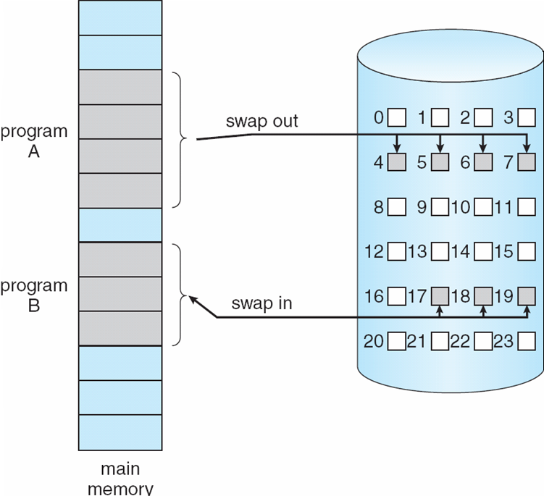
Transfer of a Paged Memory to Contiguous Disk Space

Slide 13
Basic Concept
When a process is to be swapped in, the pager guesses which pages will be used before the process is swapped out again.
Instead of swapping in a whole process, the pager brings only those pages into memory.
It avoids reading into memory pages that will not be used anyway, decreasing the swap time and the amount of physical memory needed.
There is a need to have some form of hardware support to distinguish between the pages that are in memory and the pages that are on the disk
The valid-invalid bit can be used for this purpose.
Valid-Invalid Bit
With each page table entry a valid–invalid bit is associated
(v ⇒ in-memory, i ⇒ not-in-memory)
Initially valid–invalid bit is set to i on all entries

Slide 14
Example of a page table snapshot:
During address translation, if valid–invalid bit in page table entry
is I ⇒ page fault
Frame
valid-invalid bit
v
v
v
v
i
….
i
i
page table

Slide 15
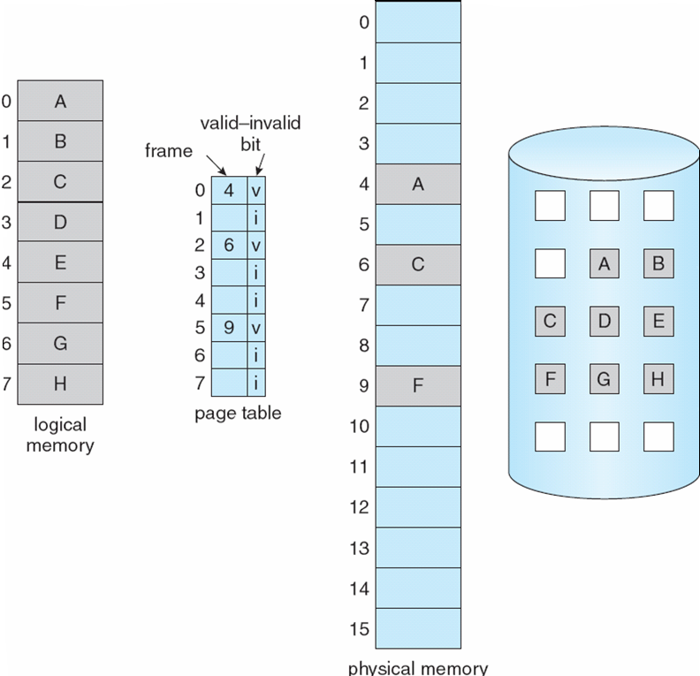
Page Table When Some Pages Are Not in Main Memory

Slide 16
Page Fault
If there is a reference to a page, first reference to that page will trap to operating system:
page fault
Operating system looks at another table to decide:
  Invalid reference ⇒ abort
  Just not in memory
Get empty frame
Swap page into frame
Reset tables
Set validation bit = v
Restart the instruction that caused the page fault

Slide 17

Steps in Handling a Page Fault

Slide 18
Process Creation
Virtual memory allows other benefits during process creation:
- Copy-on-Write
- Memory-Mapped Files
5.2 Copy-on-Write, Page Replacement
Copy-on-Write
Copy-on-Write (COW) allows both parent and child processes to initially share the same pages in memory
If either process modifies a shared page, only then is the page copied
COW allows more efficient process creation as only modified pages are copied
Free pages are allocated from a pool of zeroed-out pages

Slide 19
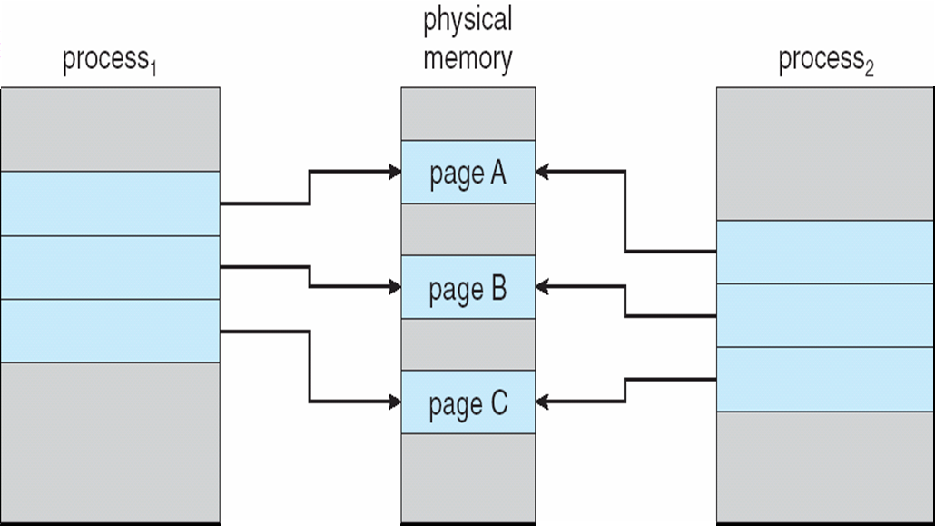
Before Process 1 Modifies Page C

Slide 20

After Process 1 Modifies Page C

Slide 21
What happens if there is no free frame?
Page replacement – find some page in memory, but not really in use, swap it out
  algorithm
  performance – want an algorithm which will result in minimum number of page faults
Same page may be brought into memory several times
Page Replacement
Prevent over-allocation of memory by modifying page-fault service routine to include page replacement
Use modify (dirty) bit to reduce overhead of page transfers – only modified pages are written to disk
Page replacement completes separation between logical memory and physical memory – large virtual memory can be provided on a smaller physical memory

Slide 22
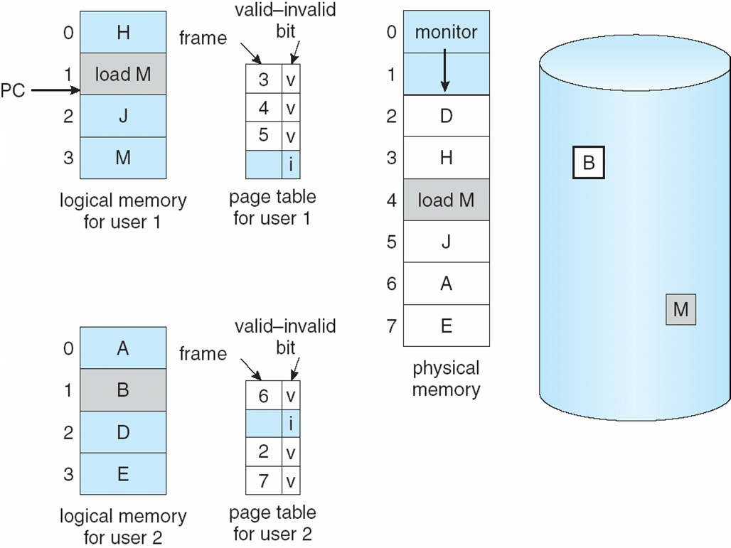
Need For Page Replacement

Slide 23
Basic Page Replacement
Find the location of the desired page on disk
Find a free frame:
- If there is a free frame, use it
- If there is no free frame, use a page replacement algorithm to select a victim frame
Bring the desired page into the (newly) free frame; update the page and frame tables
Restart the process

Slide 24
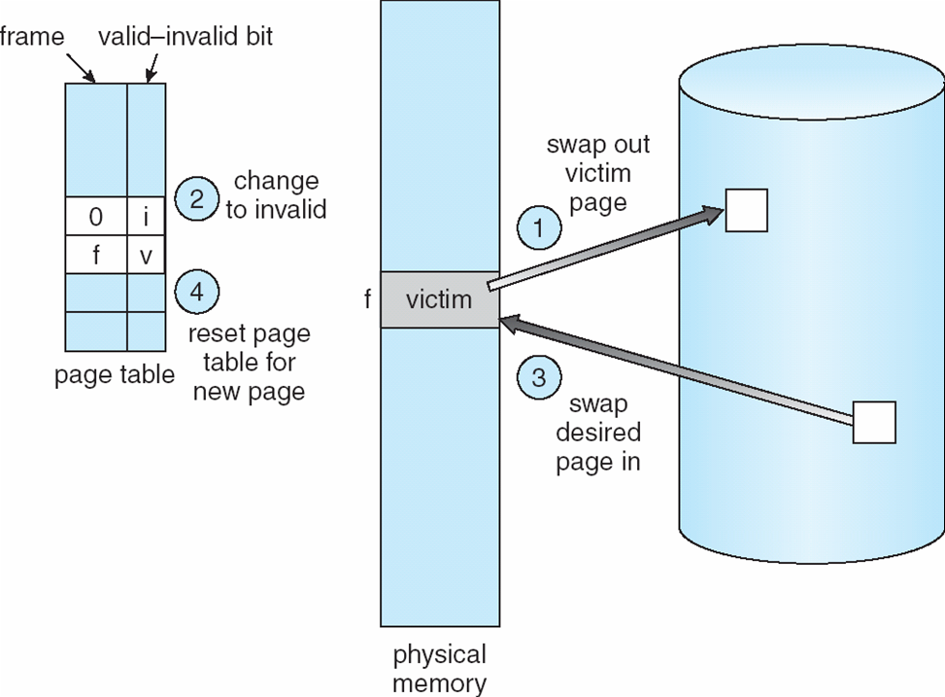
Page Replacement

Slide 25
Page Replacement Algorithms
Want lowest page-fault rate
Evaluate algorithm by running it on a particular string of memory references (reference string) and computing the number of page faults on that string
In all our examples, the reference string is
1, 2, 3, 4, 1, 2, 5, 1, 2, 3, 4, 5

Slide 26
5.3 First-In-First-Out (FIFO) Page Replacement
Reference string: 1, 2, 3, 4, 1, 2, 5, 1, 2, 3, 4, 5
3 frames (3 pages can be in memory at a time per process)
4 frames
Belady’s Anomaly: more frames ⇒ more page faults
1
1
4
5
2
2
1
3
9 page faults
3
3
2
4
1
1
5
4
2
2
1
5
10 page faults
3
3
2
4
4
3

Slide 27
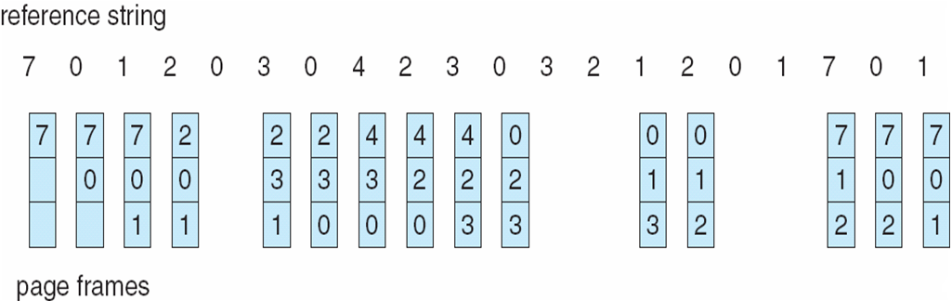
FIFO Page Replacement

Slide 28
5.4 Optimal Algorithm
Replace page that will not be used for longest period of time
4 frames example
1, 2, 3, 4, 1, 2, 5, 1, 2, 3, 4, 5
1
4
2
6 page faults
3
4
5

Slide 29
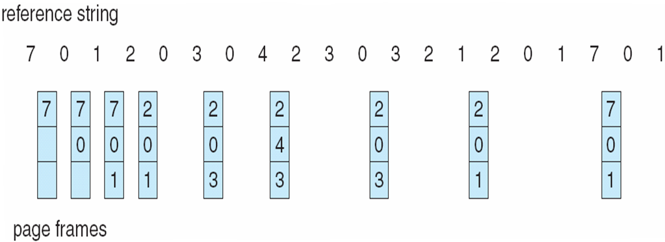
Optimal Page Replacement

Slide 30
5.5 Least Recently Used (LRU) Page Replacement
Reference string: 1, 2, 3, 4, 1, 2, 5, 1, 2, 3, 4, 5
Counter implementation
  Every page entry has a counter; every time page is referenced through this entry, copy the clock into the counter
  When a page needs to be changed, look at the counters to determine which are to change
1
1
1
1
5
2
2
2
2
2
3
5
5
4
4
4
4
3
3
3

Slide 31

LRU Page Replacement

Slide 32
5.6 Allocation of Frames
The main memory of the system is divided into frames.
The OS has to allocate a sufficient number of frames for each process and to do so, the OS uses various algorithms.
The five major ways to allocate frames are as follows
Proportional frame allocation
Priority frame allocation
Global replacement allocation
Local replacement allocation
Equal frame allocation

Slide 33
Proportional frame allocation
The proportional frame allocation algorithm allocates frames based on the size that is necessary for the execution and the number of total frames the memory has.
The only disadvantage of this algorithm is it does not allocate frames based on priority. This situation is solved by Priority frame allocation.
Priority frame allocation
Priority frame allocation allocates frames based on the priority of the processes and the number of frame allocations.
If a process is of high priority and needs more frames then the process will be allocated that many frames.
The allocation of lower priority processes occurs after it.

Slide 34
Global replacement allocation
When there is a page fault in the operating system, then the global replacement allocation takes care of it.
The process with lower priority can give frames to the process with higher priority to avoid page faults.
Local replacement allocation
In local replacement allocation, the frames of pages can be stored on the same page.
It doesn’t influence the behavior of the process as it did in global replacement allocation.
Equal frame allocation
In equal frame allocation, the processes are allocated equally among the processes in the operating system.
The only disadvantage in equal frame allocation is that a process requires more frames for allocation for execution and there are only a set number of frames.

